Slide 1

AI-Sign-Language-Voicer
The Sign Language Voicer that utilizes advanced computer vision and machine learning algorithms to recognize word-level sign language gestures. Once recognized, it translates these gestures into spoken language, providing real-time communication accessibility for the hearing impaired community.

Slide 2
Project Overview
Key Objective
Motivation
Approach
To develop a unique methodology for achieving real-time sign language translation to coherent English output.
To make communication for the Differently Abled, easier and wider.
You Only Look Once (YOLO), Natural Language Processing (NLP), Text-to-Speech (TTS)

Slide 3



Technical Approach
Data Collection
WLASL Dataset which contains over 2000 videos for over 2000 words in the
American Sign Language
Model Training
Apply deep learning techniques to train a highly accurate sign language recognition model.
Real-time Inference
Deploy the trained model on edge devices to enable fast, reliable sign language translation in real-time.

Slide 4
Key Features
1
Real-time Recognition
2
Natural Language Processing
Real-time sign language gesture recognition using YOLO.
NLP processing to interpret recognized gestures into meaningful text.
3
Low-latency Response
4
Scalable and Versatile
Real-time sign language detection and analysis, enabling immediate voicing of the word.
Can be scaled to hardware and wearable computing technologies.

Slide 5
Accuracy and Performance
Accuracy Benchmark
Real-time Processing
YOLO AI achieves over 97% accuracy on a comprehensive test dataset.
The system can process and analyze sign language signs at a rate of over 30 frames per second.
Energy-efficient Design
Scalable Architecture
The AI model is optimized for low power consumption, making it suitable for edge deployments.
The modular design allows for easy integration and scaling to meet diverse application needs.

Slide 6
Challenges and Limitations
Lighting Conditions
Deployment
Computational Constraints
Accurate sign detection can be challenging in varying or complex lighting environments.
Integrating the sign language voicer into real-world scenarios may present challenges related to deployment infrastructure, compatibility with existing systems, and user interface design
Balancing high accuracy with low latency and energy efficiency on edge devices.

Slide 7

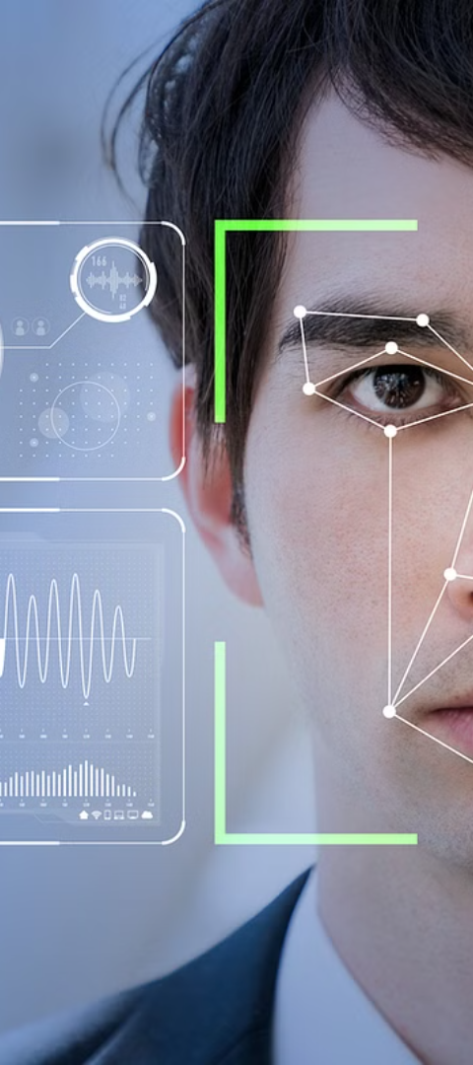
Conclusion and Next Steps
1
Continuous Improvement
Ongoing model refinement and expansion of the sign recognition capabilities.
2
Multimodal Integration
Combining this with other computer vision and sensor technologies.
3
Edge Computing Advancements
Leveraging the latest hardware and software advancements for faster, more efficient edge deployments.

